Slide 1


Slide 2
COFFEE SHOP Guided by Poonam Borase
Name:- Sonali Shakhawar
Roll No:- 26006
Name:- Tanuja Shihare
Roll No:- 26011

Slide 3

CONTENTS
Abstract
Introduction
List of Modules
Conclusion

Slide 4

ABSTRACT
We have used the various languages for Forming our Coffee Shop Website.
By using HTML we form the various pages format. Specially there Tags are been very useful. As the HTML is known as Hyper Text Markup Language it is useful for linking various pages.
For making special effect on website we use CSS is known as Cascading Style Sheets. Through its various function we make that website more attractive.
JavaScript is used in Image Manipulation, Form Validation, and Dynamic changes of contents.

Slide 5

INTRODUCTION
A website provides your customers with vital information about your coffee shop and can even act as an online store for beans and merchandise, all while providing educational and entertaining content to get customers engaged with your brand.
Coffee shops are all about speed and efficiency. You want to make sure your customers are receiving the quality service they require as quickly as possible.
There are 3 elements to control regarding the water; temperature, flavor and volume.

Slide 6

LIST OF MODULES
HOMEPAGE: Homepage is created using HTML, and CSS. Homepage consist of home, search bar where user can search for his/her required choice of flavour, Login and About us and Contact us. It also include Menu, Gallery, and blogs page are added using buttons, clicks and input types uses is HTML. It further can hold data.
WEBPAGE: Webpages are created using HTML and External CSS. The webpages are linked with each other using anchor tag and hyperlinks. Webpages consists of all the static information of places.

Slide 7
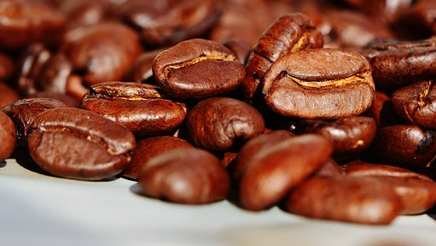
CONCLUSION
By Partnering with coffee shop varities and their Products through linking different pages. It is user friendly website so website user will get to know different types features on this website
While working on coffee shop website, we learned:
HTML Tags
CSS TAGS
JavaScript Tags
PHP connections
Database connections through Xampp and Localhost

Slide 8

THANK YOU

